Slide 1
New Traits Under Development at CDCB
John B. Cole, PhD
HAUSA Genetic Advancement Committee | February 18, 2026

Slide 2
Topics
Calf Health
Fertility Traits
Milking Speed
Hoof Health
Mobility

Slide 3

Calf Health Traits
As soon as April 2026…
  Resistance to Respiratory Disease (RSP)
    Estimated heritability = 2.2%
    Def. - Expected resistance of an animal’s offspring to calfhood respiratory problems in a herd with average management conditions
  Resistance to Diarrhea (DIA)
    Estimated heritability = 2.6%
    Def. - Expected resistance of an animal’s offspring to calfhood diarrhea or scours in a herd with average management conditions

Slide 4
Foundational Review of FertilityTraits
What data is available?
How do we edit/filter that data?
Can we improve the models?
Do the existing traits offer the best insight?

Slide 5
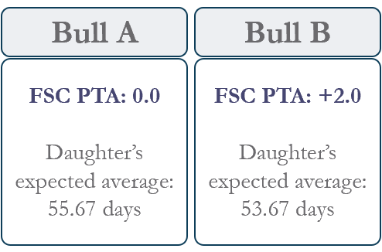
Daughter Pregnancy Rate (DPR)
Cow Conception Rate (CCR)
Daughter Conception Rate (HCR)
Early First Calving (EFC)
Predicts % of cows that will become pregnant in each 21-day cycle
Positive PTA = higher fertility in offspring expected
Predicts a lactating cow’s ability to conceive
Positive PTA = higher fertility expected
Predicts a maiden heifer’s ability to conceive
Positive PTA = higher fertility expected
Predicts ability to alter female offspring’s age at first calving
Positive PTA = earlier calving (expressed in days)
First Service to Conception (FSC)
Predicts a lactating cow’s ability to conceive as an interval trait (days)
Positive PTA = Fewer days to conception
Possible Changes
DPR formula to include VWP by herd-year and by lactation group. (proposed change)
Proposed changes center around computational efficiency, data management and edits, and some model changes.

Slide 6
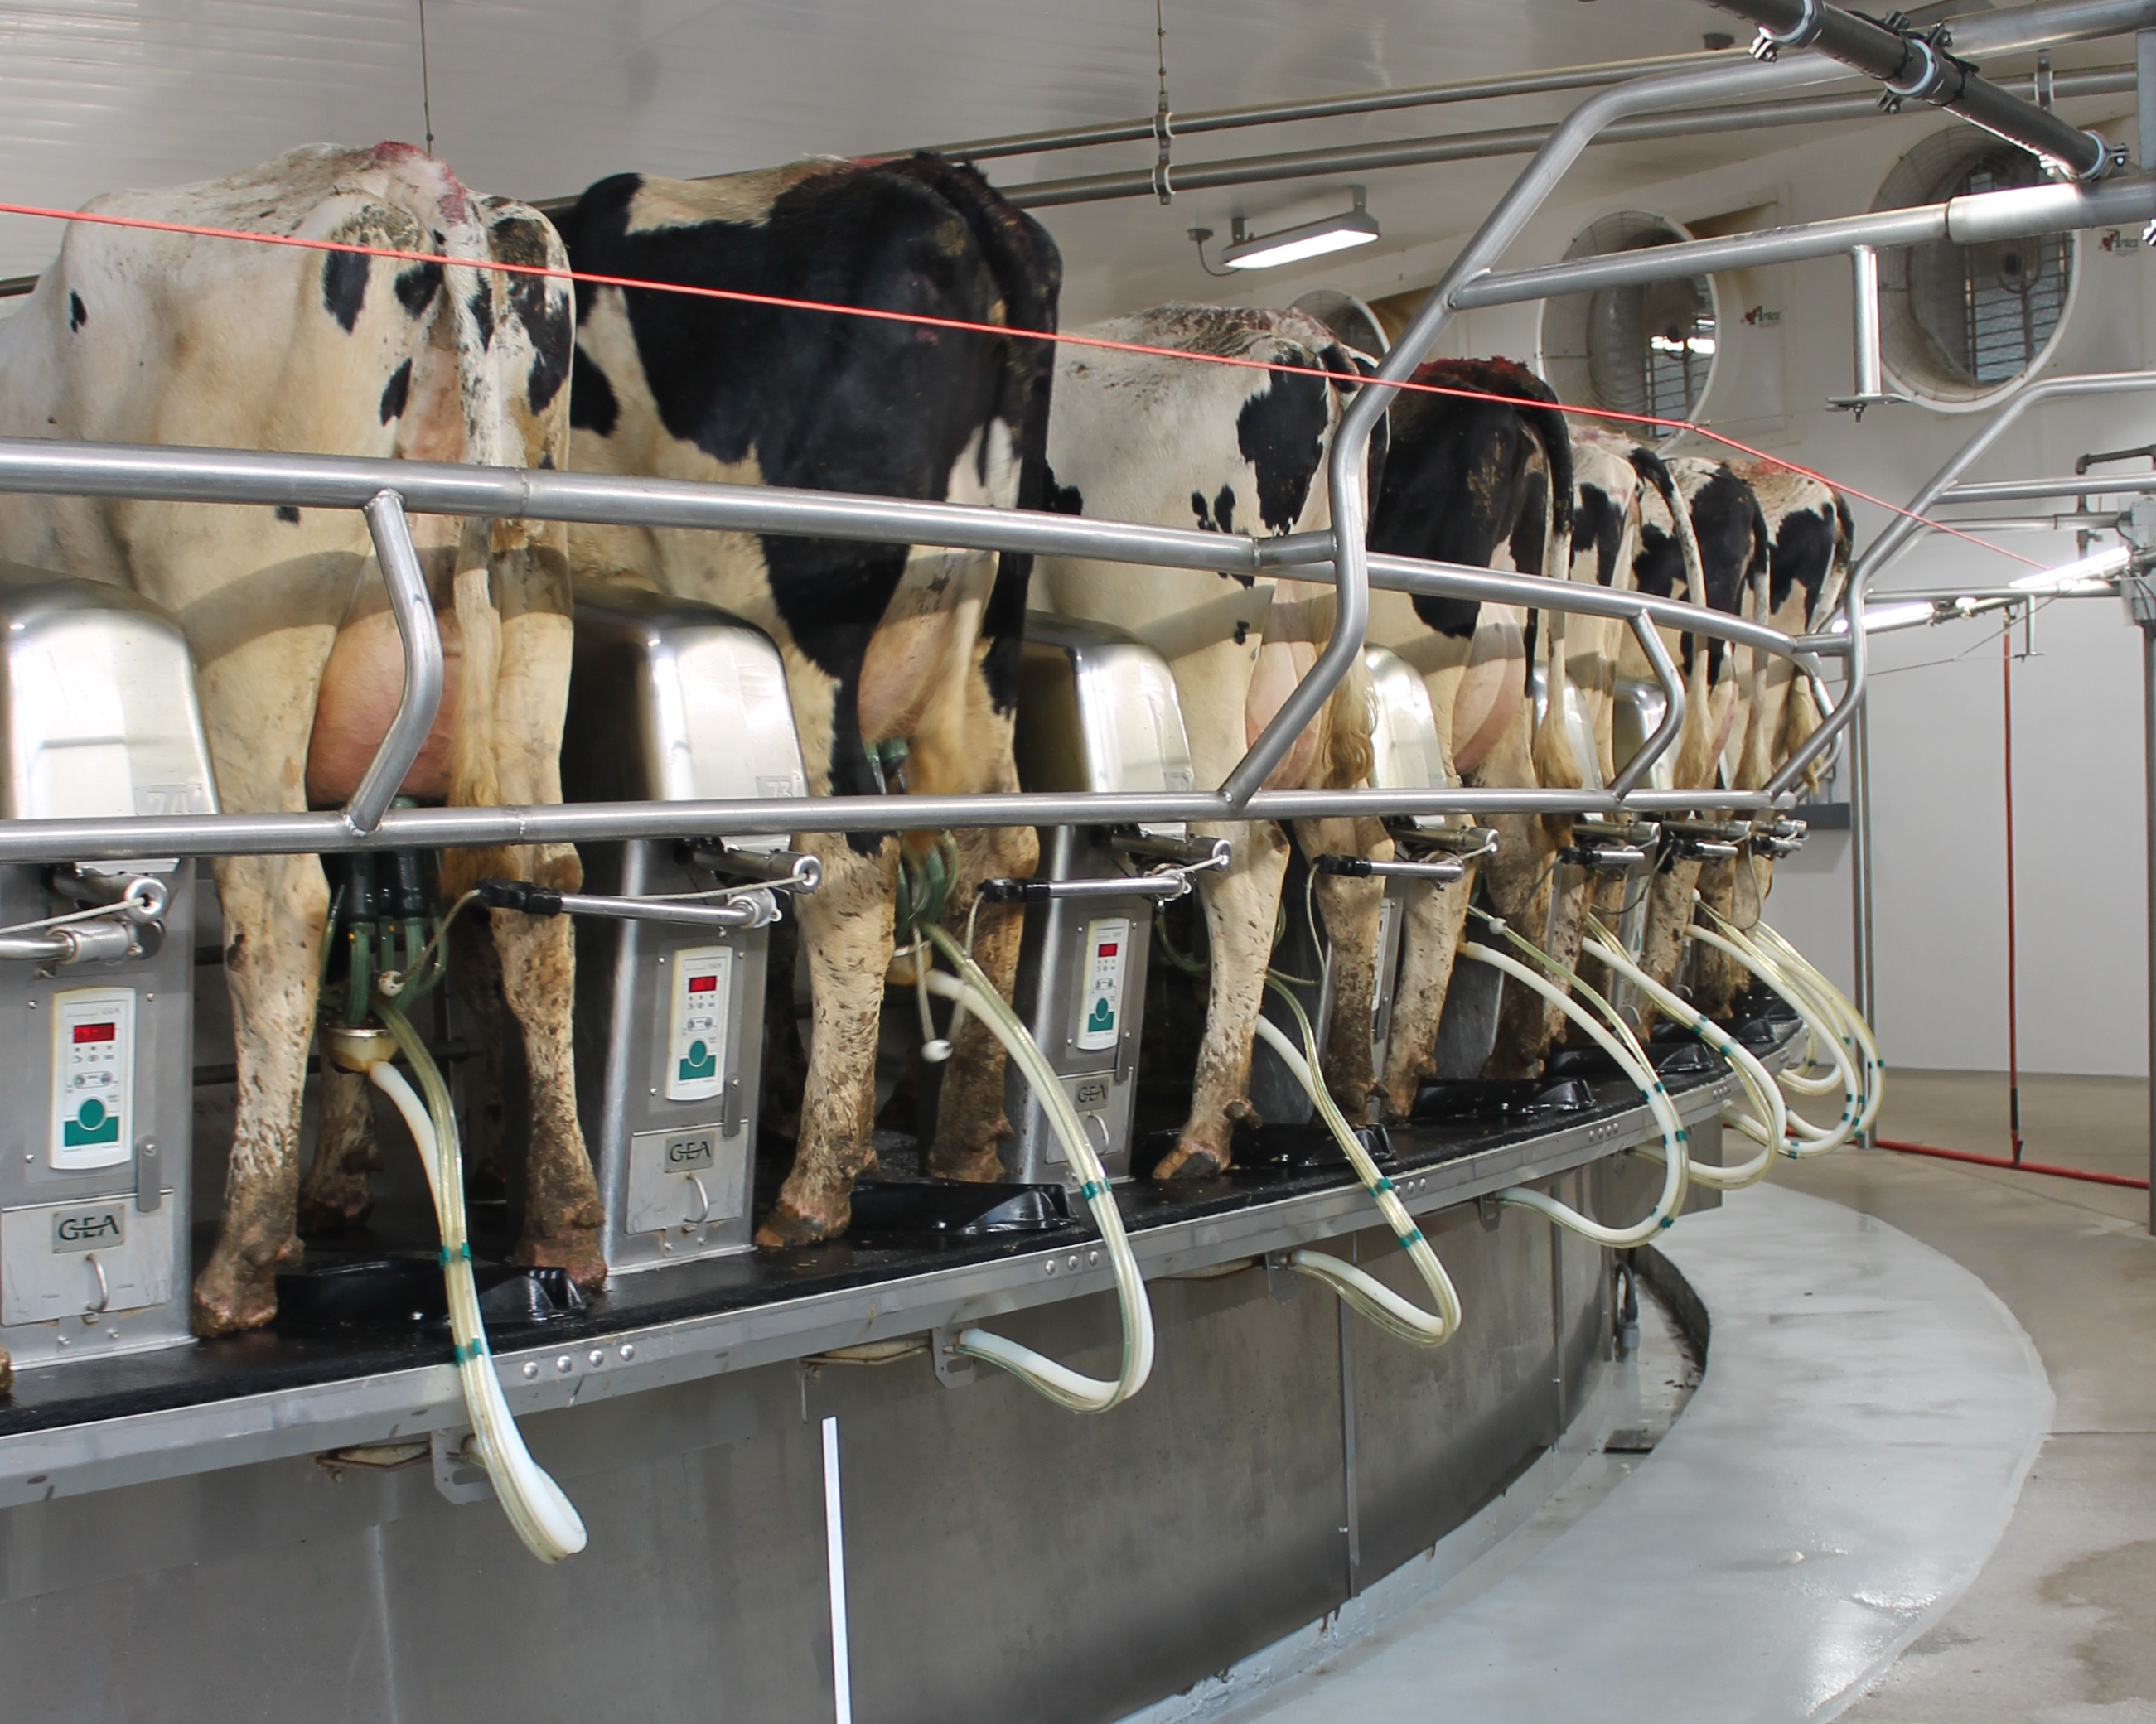
Milking Speed (MSPD)
In August 2025, it became the first trait to utilize sensor data!
Measures milk flow (lbs./minute) averaged across a lactation and based on data collected in a traditional parlor

Slide 7
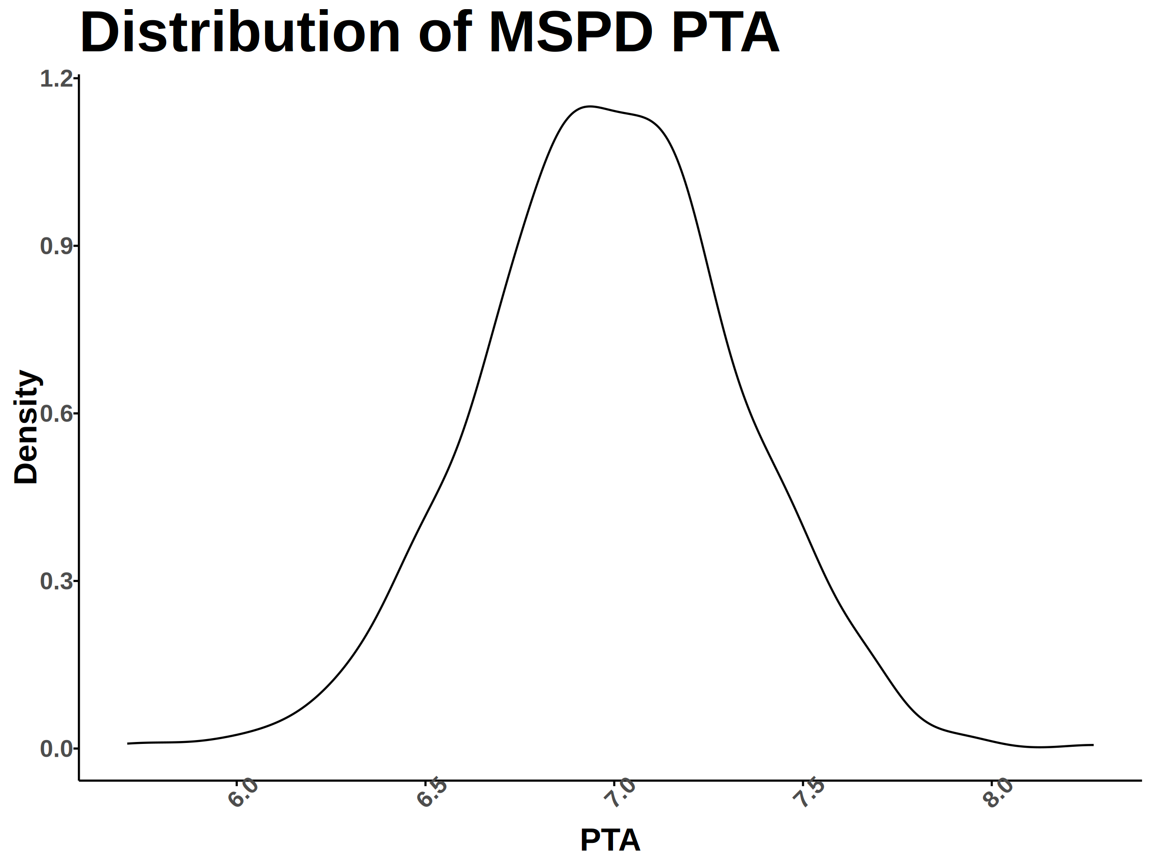
What does it mean?
PTAs are based on a Holstein phenotypic average = 7 lb./min
PTA correlation with milk yield, SCS and MAST; no other significant correlations
Slow milkers – LESS milk per minute
Fast milkers – MORE milk per minute
These are the animals we may want to avoid in the herd!
Notes:
Correlation with our mastitis traits are likely mediated due to the relationship between milk speed and milk yield

Slide 8

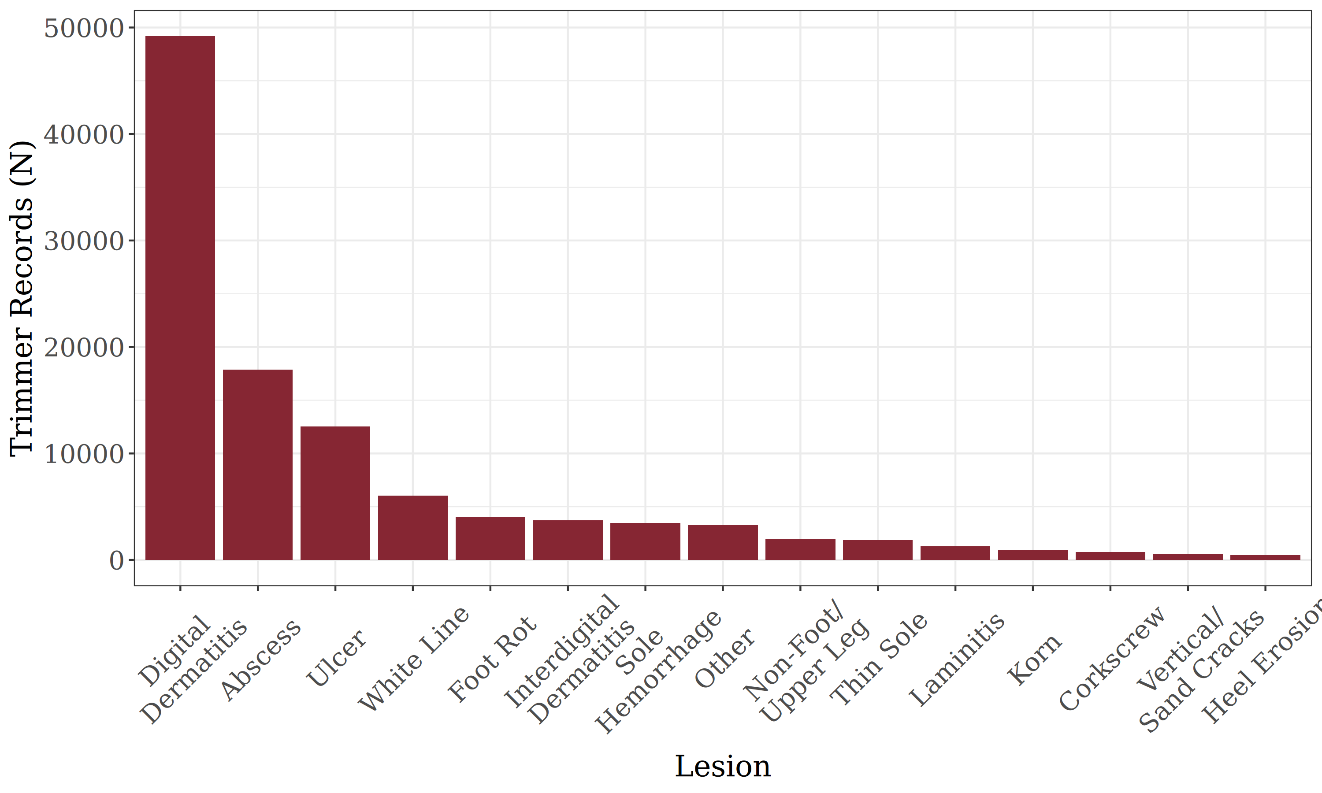
Development of a Hoof Health Trait
100k lesion events from trimmer records
  686 herds
  131k cows
  262k parities
  2009 to 2024
Will be modeled similarly to traditional health traits
Notes:
emphasize need healthy as much as lame

Slide 9
Future Implementation of a Hoof Health Trait
Digital Dermatitis
Abscess
Interdigital Dermatitis
Heel Erosion
Foot Rot
Hoof Health Trait Groups
Infectious
Non-Infectious
Plan is for initial release of two correlated hoof health traits: Infectious and Non-Infectious Lesions
Ulcer
White Line Separation
Sole Hemorrhage
Thin Sole
Laminitis
Vertical/Sand Cracks
Corn/Fibroma
Corkscrew
Non-Foot/Upper Leg/Other
Notes:
Emphasize that we see evidence of a common genetic basis for these groups. By grouping lesions this way we can select for resistance to infection in general. Similarly, there may be certain biological factors with a genetic basis that predispose cows to developing metabolic and other non-infectious lesions

Slide 10
Future Implementation of a Hoof Health Trait
Hoof Health Trait Groups
Infectious
Digital Dermatitis
Non-Infectious
Plan is for initial release of two correlated hoof health traits: Infectious and Non-Infectious Lesions
As records increase, certain lesions may become separate traits
Ex: HOOF$

Slide 11
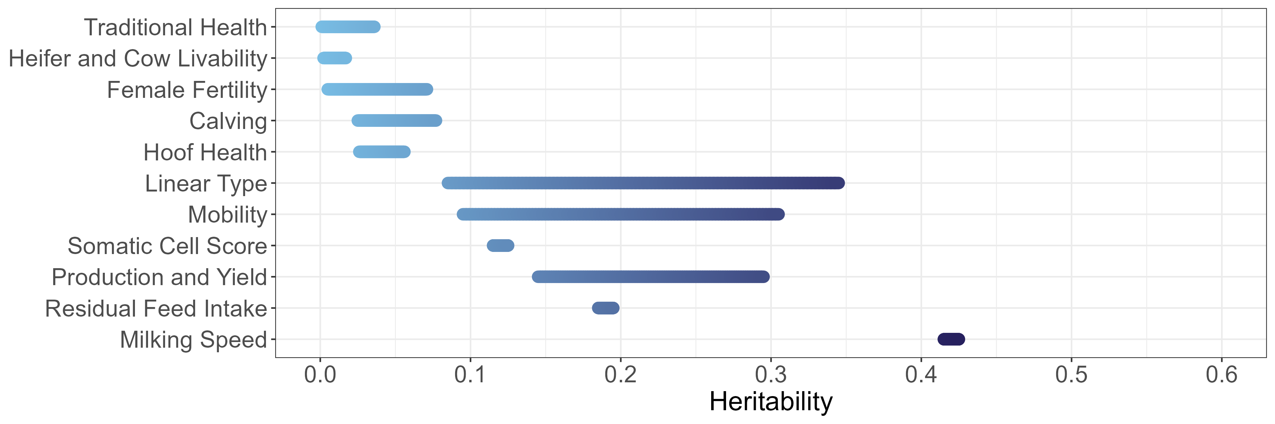
Hoof Health is Heritable
*
*
3-5%

Slide 12
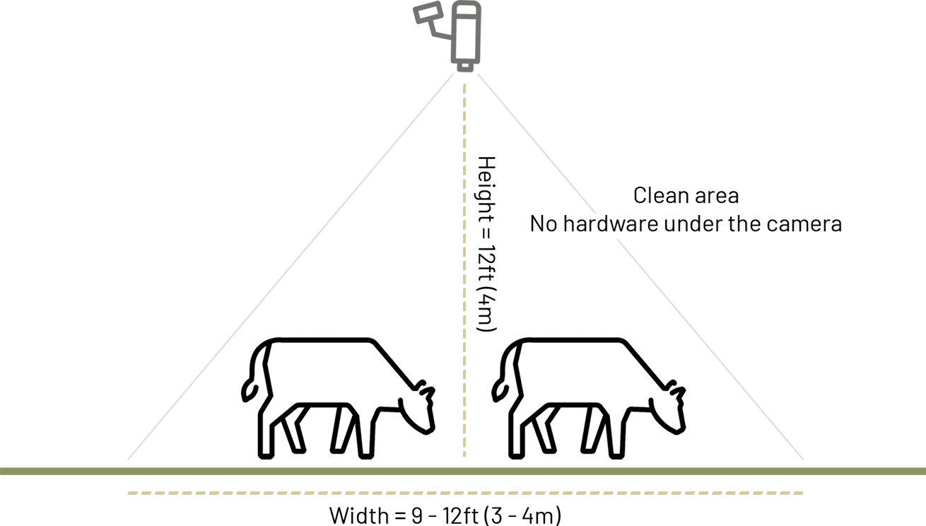

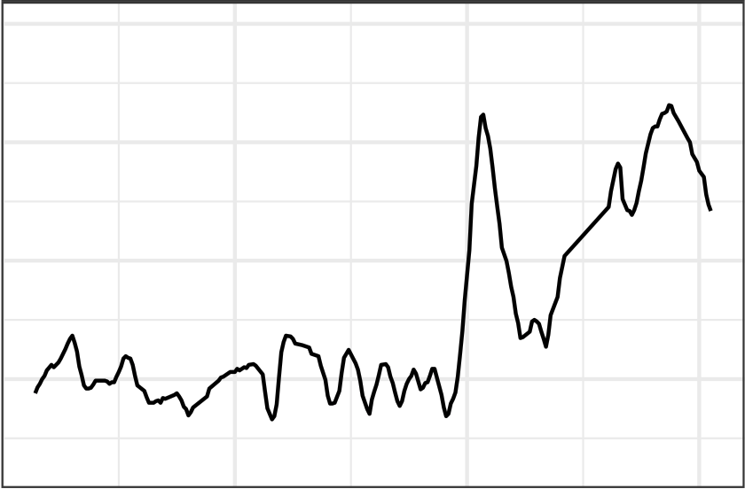
Daily Mobility Scores
In R&D
Scaled 1 (Healthy) – 100 (Lame)
6 participating commercial farms
63k cows with ~14 million daily mobility scores (and growing)
  Also have: 600k trim events
Daily data: high dimensionality!

Slide 13
Mobility is Heritable
*
*
10-30%

Slide 14

Check out the CDCB CowCast!
The first episode features Dr. Kristen Gaddis talking about calf health.
Available on CDCB’s YouTube channel: https://youtu.be/4Sd0mDKfYT8.

Slide 15
Acknowledgments
U.S. dairy producers
Member sectors and collaborators
USDA AGIL
CDCB staff

Slide 16
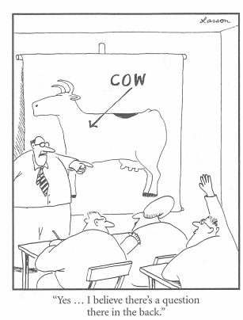
Questions?
Thank you for your
interest!
john.cole@uscdcb.com

